Slide 1


OVERVIEW OF A CASENET.CA
CASE
Made with https://logomakr.com/

Slide 2

The Speaker (Manager) in the case faces a specific Issue.
Users can see the Speaker’s:
Issue
Cause
Background
Notes:
Bring font down

Slide 3
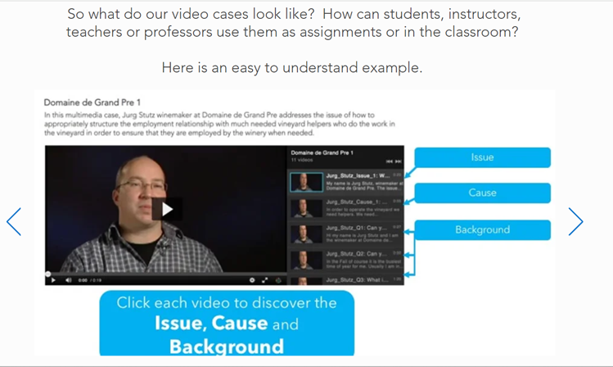

Slide 4
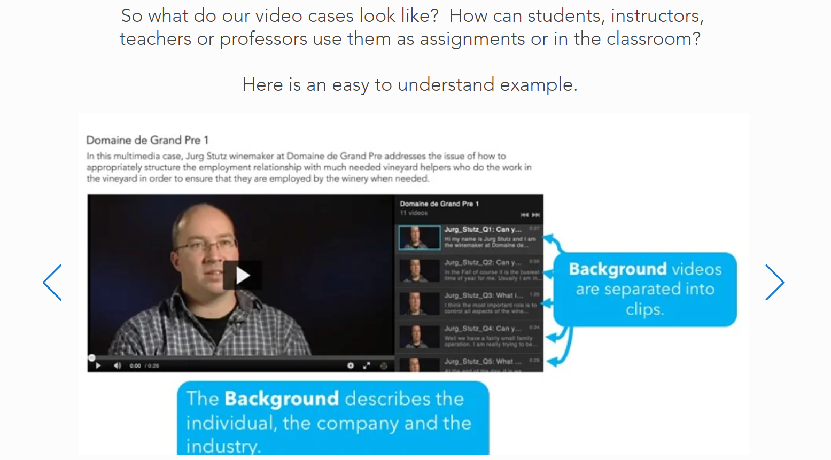

Slide 5
Thank you!
Continue exploring our cases at CaseNet.ca

